Slide 1


Angular 4
Angular 4 with typescript 2.6.1

Slide 2
A JavaScript framework For building client-side applications Using HTML, CSS and JavaScript

Slide 3
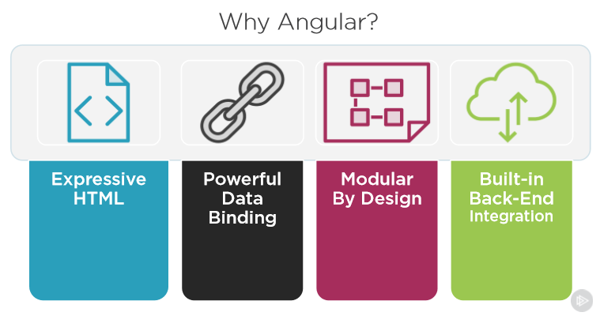

Slide 4
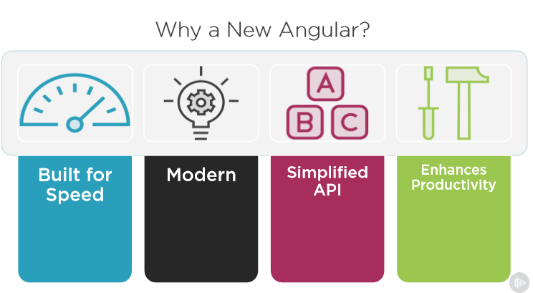

Slide 5
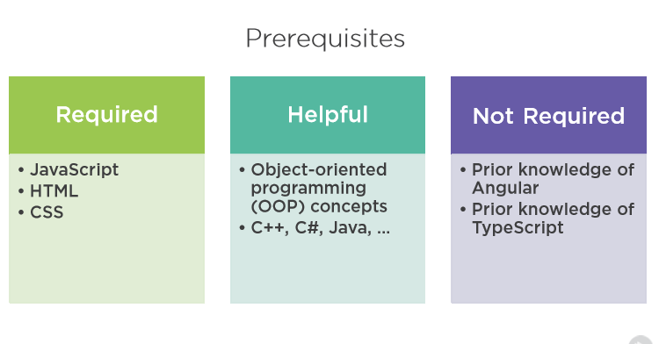

Slide 6
Boring? Alright let’s start some things happening !

Slide 7

Let’s begin by a story
In May 27, 2009 (8 years ago) a man named Ryan Dahl has found a technology called node JS.
it's totally free yet powerful
open source server framework ,
runs on various platforms (Windows, Linux, Unix, Mac OS X, etc.)
JavaScript based server

Slide 8
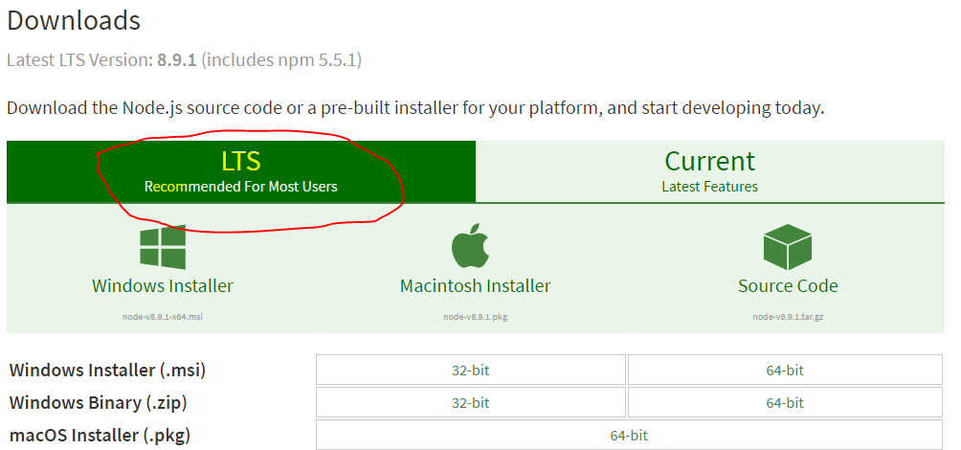
Install node.js
Go to this address
https://nodejs.org/en/download/
Click on the LTS button marked in the picture and download the package . And with the defaults install the program

Slide 9
Check things up.
Installed package has 2 main components.
NPM – Node package manager
Confirm this by using command prompt
Open the command prompt and run the following command.
npm –v (>3.10.10)
Node.js – Node js server package
To confirm this run following command
node –v (>v6.11.3)
Just after you have seen this! Yep you done !
But wait some few more steps to go there

Slide 10
Is that it?
NO
Now you have make the stage for the main event yet to come. By installing node.js along with node package manager will make the platform to angular to run
Angular ? Huh!
Yup let’s install it now!
Go to the same command prompt as an administrator and run followings
This will install the angular CLI (command line interface) . –g switch ensures that package installed globally . @angular/cli is the alias for the package.

Slide 11

Creating a new application
First of all go the a drive on your pc and make a new folder for angular developments. Because angular about to download lot more files you will need to make a separate place for those.(assume folder name is “dev”)
To create a new app, go to the newly created folder dev and run following command
This will create a new folder name “myapp” on the “dev” folder and angular will create a new set of file witch we call an angular application

Slide 12
What the …. Why This taking so long???
Yes this process take some time because it will download dependency packages (or helper packages) from the CDN
CDN? - Content developer network
If you browse the newly created folder and find a file name package.json and open it then you will see a section called
dependencies{}
EX: "@angular/animations": "^4.2.4"
These are the packages that npm is downloading now. They are the required building blocks of an angular app.
Angular application cannot run without these depenancies. But if you look right down below you will see devDependencies
devDependencies only useful when development of an app.

Slide 13

Run! Run ! Run…………….
Running angular app for the first time is the most fun time of all times. But it soon to be changes when you start some coding
To run the application hit this command on a empty command prompt
Ng serve is the most typed command in angular word so far and it will run the node.js server in the background and Transpile the angular application in to of it and runs
Transpile - taking source code written in one language and transforming into another language that has a similar level of abstraction
If you seen closer at the command window you will find out following line
* NG Live Development Server is listening on localhost:4200, open your browser on http://localhost:4200/ **
Open your bowser and navigate to localhost:4200
you just ran your first angular app!!!

Slide 14
Application Architecture

Slide 15
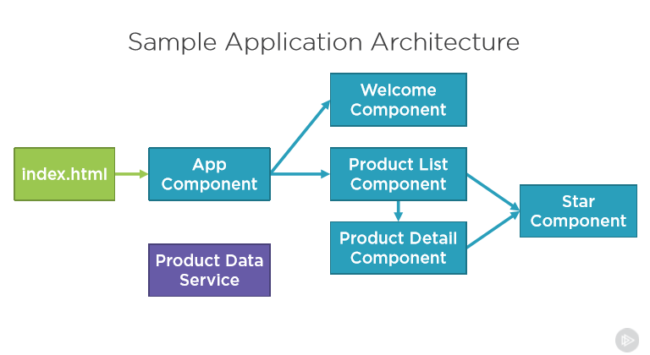

Slide 16
Doesn’t make any sense?
The first file of the angular running circle is the index.html file. This is a pure html5 file . It will contain header body and footer like an usual html file
App component is the main part runs after the index.html.
All other component are called from the main app component . This is a common SPA scenario .
SPA – Single page applications
Components are the main block that builds an angular application. To help functioning a component there are various helpers involved.
Services are the main helpers that helps functioning a component . A service tidily or loosely couple to an complement . Also some services may share among may components

Slide 17
END !

